Slide 1

Predictive Analytics for Business Strategy

Slide 2
By the end of this class, you should be able to:
Understand some functional form issues for our models.
Have a sense of what a difference-in-differences model can accomplish.
Have a sense of what panel data can allow us to control for.

Slide 3
Form of the Determining Function

Slide 4
Form of the Determining Function
Everything we’ve seen in econometrics has involved a functional form assumption
This forces the relationship between Y and the Xs to take a certain shape
Usually, we assume a linear relationship
E.g., Output_{i} = α + β₁Labor_{i} + β₂Capital_{i} + ε_{i}
There are many other options:
Quadratic
Cubic
Log
Etc.

Slide 5
Form of the Determining Function
Given we are going the parametric route, how do we decide the form of the determining function for a given variable?
Consider three features of the determining function:
Flexibility
Precision
Exposition

Slide 6
Form of the Determining Function
The shape (functional form) you assume for the relationship between X and Y may be too restrictive
That is, it may not have enough flexibility
Another well-known example can illustrate
Consider the Laffer Curve, and suppose its “true” shape is a hill
Revenue
Laffer Curve
Tax Rate

Slide 7
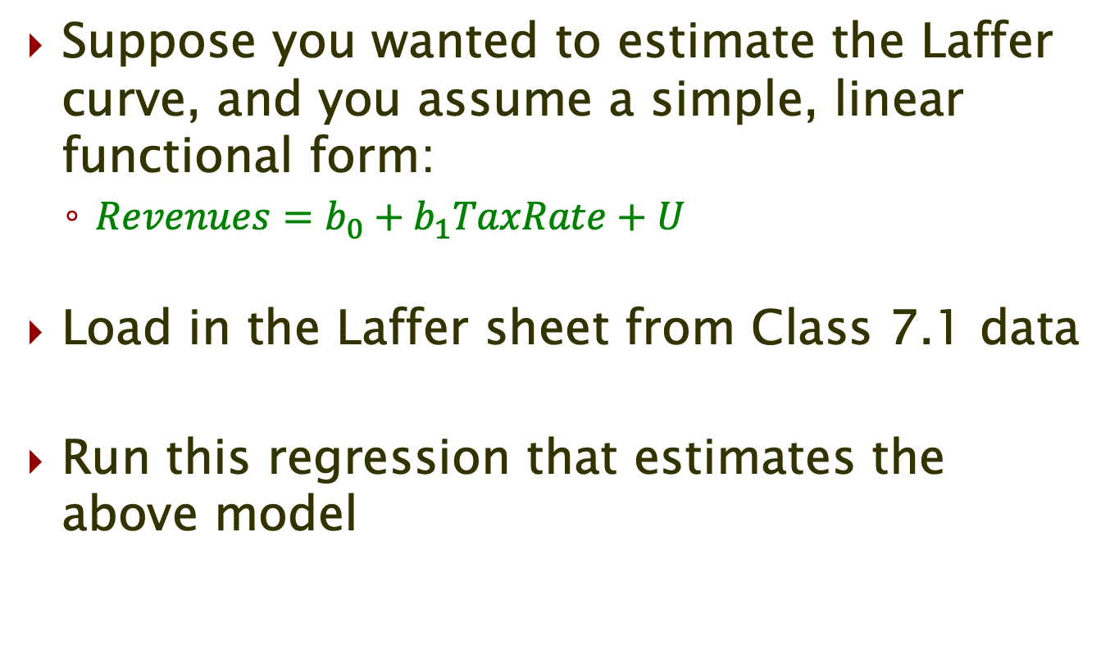
Form of the Determining Function
Suppose you wanted to estimate the Laffer curve, and you assume a simple, linear functional form:
$Revenues=b_{0}+b_{1}TaxRate+U$
Load in the Laffer sheet from Class 7.1 data
Run this regression that estimates the above model

Slide 8
Form of the Determining Function
According to this regression, what is the revenue maximizing tax rate?

Slide 9
Form of the Determining Function
According to this regression, what is the revenue maximizing tax rate?
100%

Slide 10
Form of the Determining Function
What is a definite reason that our revenue maximum solution is nonsensical?
The tax rates are mis-measured
We forced a linear relationship when it’s likely quadratic
We have a selected sample
We have too few observations

Slide 11
*Form of the Determining Function
What is a definite reason that our revenue maximum solution is nonsensical?
The tax rates are mis-measured
We forced a linear relationship when it’s likely quadratic
We have a selected sample
We have too few observations

Slide 12
Form of the Determining Function
Problem?
You forced a linear relationship when it was actually quadratic
This can have dire consequences
In this case, you may estimate a nearly flat line (little to no relationship) despite there being a strong (quadratic) relationship between Tax Rates and Revenues

Slide 13
Form of the Determining Function
How to add flexibility?
Simplest solution is to add higher order terms and see if they are “significant”
This allows for your assumed relationship to take a wider range of shapes
And it allows the data to tell us which shape is “best”
Back to the Laffer curve
We could add a quadratic term, and to be even more flexible, a cubic term…
Revenue = β₀ + β₁TaxRate+ β₂TaxRate²+ β₃TaxRate³ + U

Slide 14
Form of the Determining Function
Back to STATA – estimate the “Laffer curve” with quadratic and cubic Tax terms
The data have helped pin down the proper shape

Slide 15
Form of the Determining Function
Regarding flexibility:
We know we can get a more flexible function by adding higher order terms
However, the cost of including these terms is like the cost of including irrelevant variables
They are likely correlated with the lower order terms, and if they don’t affect the outcome, they serve only to make it harder to pin down the effects of the lower order terms

Slide 16
Form of the Determining Function
Regarding exposition:
A highly flexible functional form can make for difficult exposition
Suppose we are interested in the marginal effect of Salary on Sales, controlling for Experience:
Now, suppose we add flexibility with an expanded functional form:
$${Sales}_{i}=β_{0}+β_{1}{Salary}_{i}+β_{2}{Salary}_{i}^{2}+β_{3}{Experience}_{i}+u_{i}$$

Slide 17
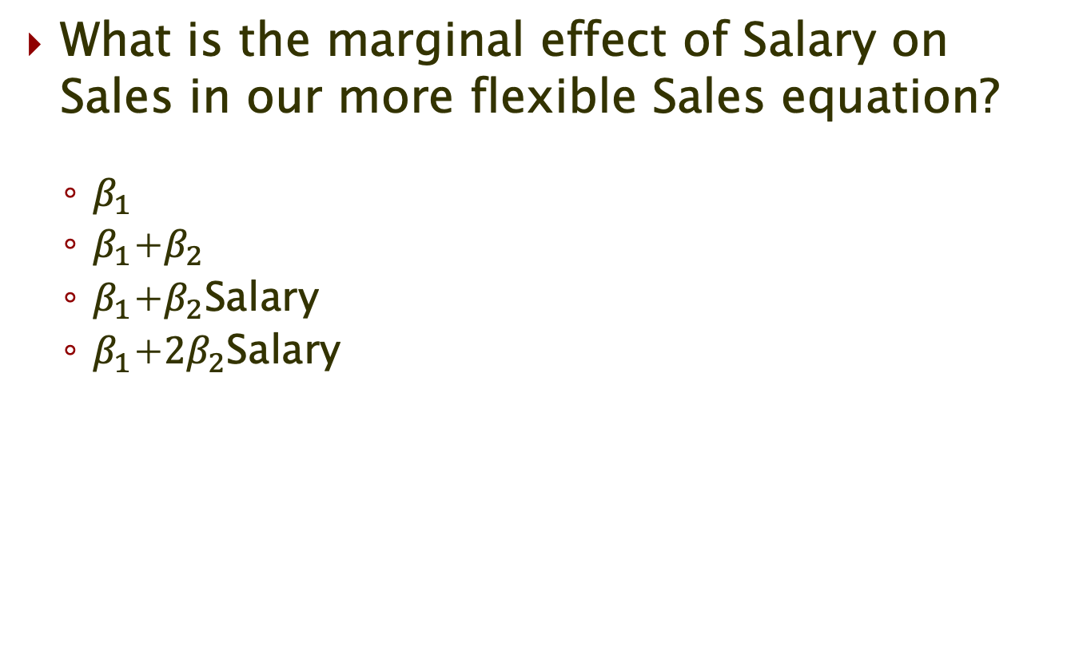
Form of the Determining Function
What is the marginal effect of Salary on Sales in our more flexible Sales equation?
$β_{1}$
$β_{1}$+$β_{2}$
$β_{1}$+$β_{2}$Salary
$β_{1}$+${2β}_{2}$Salary

Slide 18
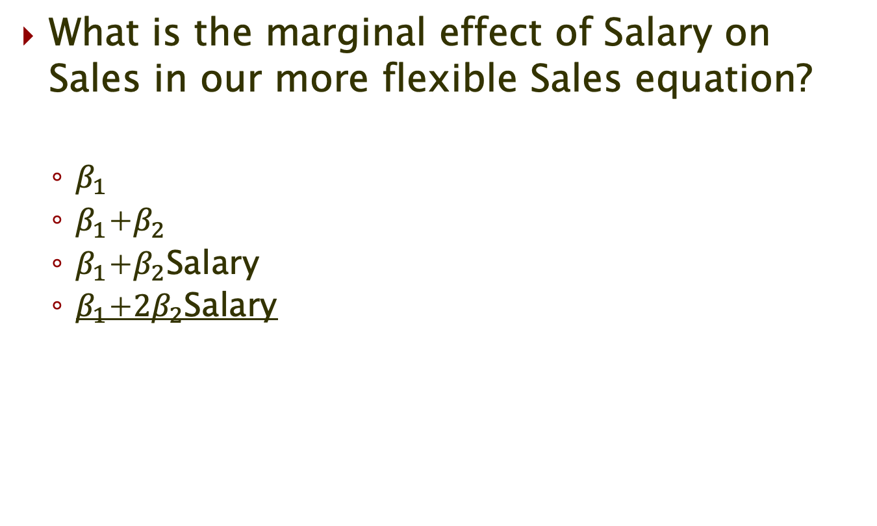
*Form of the Determining Function
What is the marginal effect of Salary on Sales in our more flexible Sales equation?
$β_{1}$
$β_{1}$+$β_{2}$
$β_{1}$+$β_{2}$Salary
$β_{1}$+${2β}_{2}$Salary

Slide 19
Panel Data Methods

Slide 20
Difference-in-Differences
When we have panel data, we have to worry about 3 types of characteristics
Those that:
Are constant over time
Those that change over time, but change the same (amount or percentage) for all entities.
Those that change over time and change differently for one or more entities.
Panel data gives us tools (some “silver bullets”) to control for some of these all at once.

Slide 21
Difference-in-Differences

Slide 22
Difference-in-Differences
Recall our “big picture” problem
We’re interested in the effect of various treatments, but we don’t believe they were randomly assigned
Many datasets are in the form of a panel – what does this mean?
A panel dataset includes observations on the same units over time
For example, observing the sales for the same set of Best Buy stores over time would constitute a panel
Each sales observation is Sales_{it}
When data are in the form of a panel, this gives us a key tool for attacking an endogeneity problem.

Slide 23
Difference-in-Differences
A working example:
Suppose you own several liquor stores
Some in Indiana, and some in Michigan
Now, imagine Indiana passes a 5% tax increase on liquor Sales
You may be interested in the effect of this tax hike – why?
This can help pin down customers’ price responsiveness

Slide 24
Difference-in-Differences
Load in the second spreadsheet from Class 7.1 data
You see Profits for each of your stores at each time period (year)
You know the store identification and location (state)
You know the time (year) of each Profits record

Slide 25
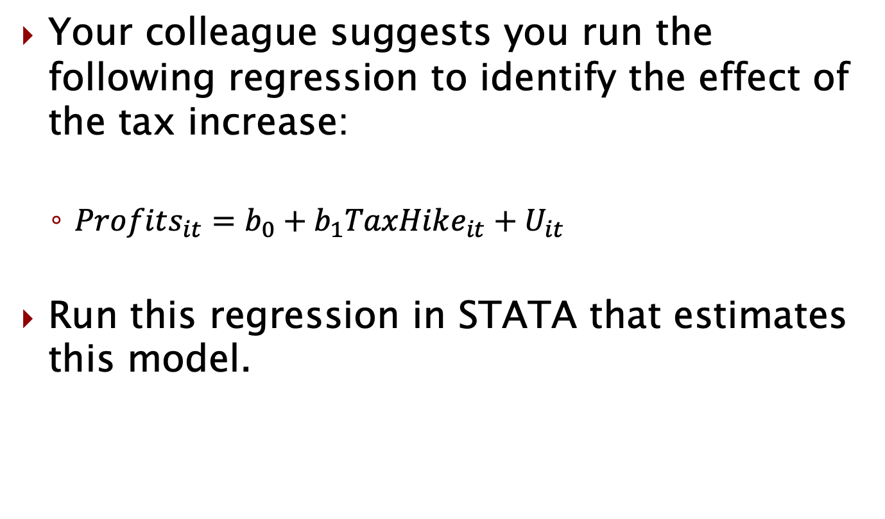
Difference-in-Differences
Your colleague suggests you run the following regression to identify the effect of the tax increase:
$Profits_{it}=b_{0}+b_{1}TaxHike_{it}+U_{it}$
Run this regression in STATA that estimates this model.
Notes:
Note that TaxHike is a 0-1 variable (dummy variable).

Slide 26
Difference-in-Differences
It appears that the tax hike lowered Profits by more than 250 units
Should we use this to make predictions about any further tax hikes?

Slide 27
Difference-in-Differences
It appears that the tax hike lowered Profits by more than 250
Should we use this to make predictions about any further tax hikes?
No

Slide 28
Difference-in-Differences
Why shouldn’t we use our regression of profits on the tax hike to make predictions about the impact of future tax hikes?
Tax hikes cannot impact profits
Tax hikes are likely correlated with other factors impacting profits
Tax hikes suffer from selection bias
Tax hikes are always randomly assigned

Slide 29
*Difference-in-Differences
Why shouldn’t we use our regression of profits on the tax hike to make predictions about the impact of future tax hikes?
Tax hikes cannot impact profits
Tax hikes are likely correlated with other factors impacting profits
Tax hikes suffer from selection bias
Tax hikes are always randomly assigned

Slide 30
Difference-in-Differences
Why might we think TaxHike is endogenous?
There are two obvious ways that observations having a tax hike might be “special”
They’re all in Indiana
Perhaps Indiana Profits are generally different from Michigan Profits
Specifically, what if Indiana Profits, in general, are lower than Michigan Profits?
They’re all in the second period
Perhaps Profits in the second period are different than Profits in the first period
Specifically, what if Profits in the second period, in general, are lower than Profits in the first period?
Notes:
By special, we mean that they have unobservables influencing Profits that differ from other observations.

Slide 31
Difference-in-Differences
Intuition for #1:
If Indiana’s tax was 5% higher than Michigan’s, it wouldn’t make sense to compare average Profits over one month and attribute differences to the effect of the tax
Many other factors could be causing Profits differences across states (e.g., population, competition)
Intuition for #2:
If Indiana raised its tax by 5% on July 1, it wouldn’t make sense to compare average Profits before and after July 1 and attribute differences to the effect of the tax
Many other factors could be causing Profits differences over time (e.g., seasonal effects, market shocks)

Slide 32
Difference-in-Differences
If we run our initial regression, we are making both mistakes
The tax hike occurred in Indiana, and Indiana may have different Profits than Michigan for other reasons
The tax hike occurred in period 2, and period 2 may have different Profits than period 1 for other reasons
How can we eliminate these problems?
Add controls
Sounds like our original solution, but the panel nature of our data allows for specific types of controls…

Slide 33
Difference-in-Differences
What should our new regression equation (with controls) look like?
We can simply estimate the above model. The following model is equivalent when we have a binary treatment and 2 periods.
Why are the two models equivalent?
$$Profits_{it}=b_{0}+b_{1}Indiana_{it}+b_{2}After+b_{3}TaxHike_{it}+U_{it}$$
$$Profits_{it}=b_{0}+b_{1}Indiana_{it}+b_{2}After+b_{3}Indiana_{it}∗After+U_{it}$$
Notes:
Note that Indiana = 1 if the state is Indiana and 0 if it’s Michigan. After = 1 if it’s the second period and 0 if it’s the first.
TaxHike is 0-1, and only equals 1 if we’re in Indiana in Period 1. Indiana*After is 0-1 and only equals 1 if we’re in Indiana in Period 1.

Slide 34
Difference-in-Differences
What does β₃ measure?
It is the difference in the temporal change in Profits between the treated state (Indiana) and the untreated state (Michigan)
This is generally known as the difference-in-differences (“diff-in-diff”)
It is the difference (across states) in the difference (across time)

Slide 35
Difference-in-Differences
Visually, we have:
Profits in Indiana in Period 1
Profits in Indiana in Period 2
Difference = β₂+ β₃
Profits in Michigan in Period 1
Profits in Michigan in Period 2
Difference = β₂
Difference-in-Differences = β₃
Notes:
Using the basic regression model, show on the board how we get these simple differences.
Note that β₁ is still important – it is differenced out when performing the first differences.

Slide 36
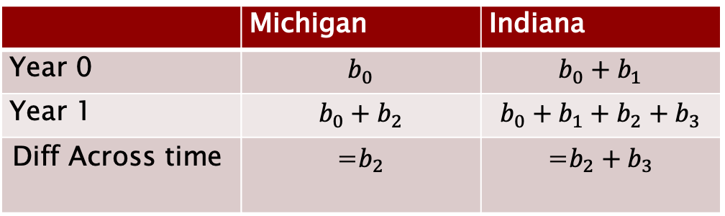
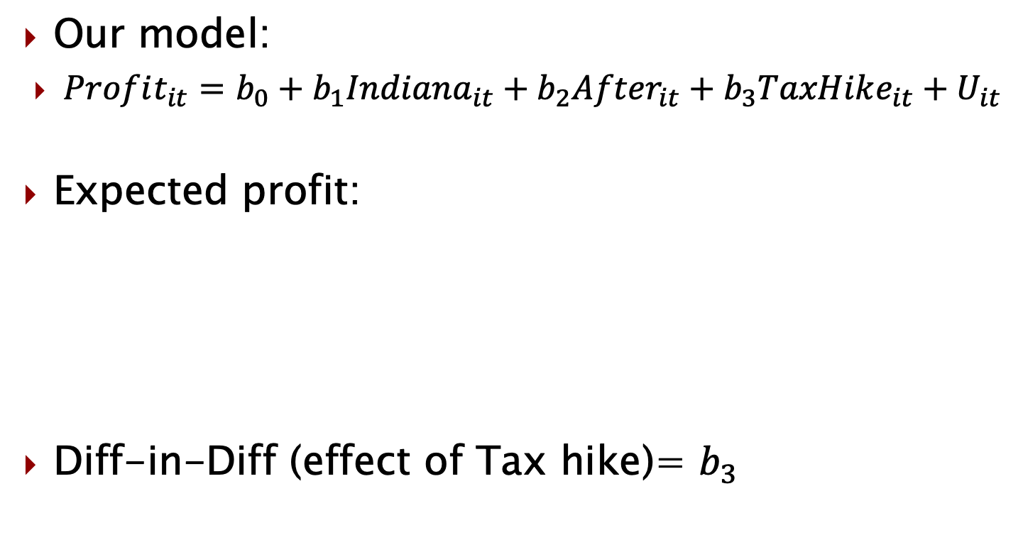
The difference-in-differences model
Our model:
$Profit_{it}=b_{0}+b_{1}Indiana_{it}+b_{2}{After}_{it}+b_{3}TaxHike_{it}+U_{it}$
Expected profit:
Diff-in-Diff (effect of Tax hike)= $b_{3}$
 | Michigan | Indiana
Year 0 | $$b_{0}$$ | $$b_{0}+b_{1}$$
Year 1 | $$b_{0}+b_{2}$$ | $$b_{0}+b_{1}+b_{2}+b_{3}$$
Diff Across time | =$b_{2}$ | =$b_{2}+b_{3}$

Slide 37
Difference-in-Differences
Is our diff-in-diff model perfect?
No – it’s still possible we’ve missed something
Specifically, what if there are other (unobserved) factors that caused Indiana Profits to change between period 1 and period 2?
For example, it could be that there was a significant population change specific to Indiana over that time
However, the diff-in-diff model ensures our conclusion of causality is vulnerable only to these types of unobserved variables
So, the assumption you audience must buy is very clear: “There was nothing else that affects Profits that changed only in Indiana during this time.” (meaning changed differently in IN than it did in MI)
Let’s compare explicitly the “naïve” model with the diff-in-diff model to clearly see the vulnerabilities of each…

Slide 38

Difference-in-Differences
Naïve:
Diff-in-Diff:
Characteristics constant over time
Characteristics that change in parallel
$$Profits_{it}=b_{0}+b_{1}TaxHike_{it}+U_{it}$$
Characteristics that change differently
for Indiana than for Michigan
$$Profits_{it}=b_{0}+b_{1}Indiana_{it}+b_{2}After+b_{3}TaxHike_{it}+U_{it}$$
Characteristics that change differently
for Indiana than for Michigan

Slide 39
Difference-in-Differences
Let’s go ahead and run this regression in Stata:
We don’t have to separately subtract to get the difference in differences, that just shows us intuitively what we’ve controlled for when we look at the coefficient on TaxHike.
$$Profits_{it}=b_{0}+b_{1}Indiana_{it}+b_{2}After+b_{3}TaxHike_{it}+U_{it}$$

Slide 40
Difference-in-Differences
Since we give it a special name of Diff-in-Diff, you may have the impression that there’s some special command or model we use.
That’s not the case for the most part. It’s just a standard regression, but we argue there is:
A clear before and after
Clearly separated treatment groups (and/or untreated)
No change in behavior that anticipates the change in policy/price

Slide 41
The Fixed Effects Regression Model

Slide 42
Fixed Effects Model
What if there are many treatments?
E.g., what if there are many different tax levels?
In this case, the treatments may vary across units (states) and across time
In our example, we may observe many states over many periods, and the tax rates vary along both dimensions
Now, there is no clear “treatment group” or “treatment time”

Slide 43
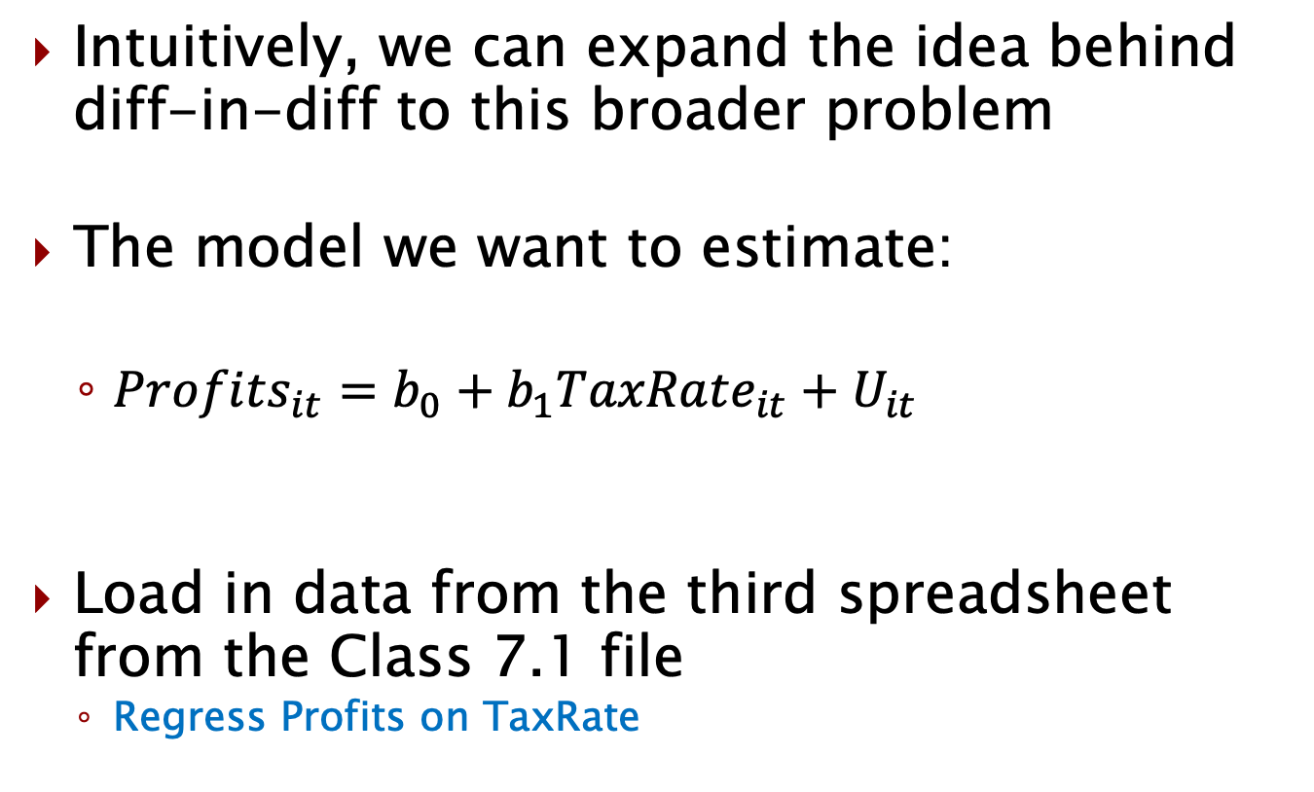
Fixed Effects Model
Intuitively, we can expand the idea behind diff-in-diff to this broader problem
The model we want to estimate:
$Profits_{it}=b_{0}+b_{1}TaxRate_{it}+U_{it}$
Load in data from the third spreadsheet from the Class 7.1 file
Regress Profits on TaxRate

Slide 44
Fixed Effects Model
Results suggest that increasing taxes by 1 percentage point lowers Profits by about 42
Should we believe this at face value?
Which of our assumptions is at greatest risk of being untrue?
We may not believe tax rates are uncorrelated with unobservables influencing Profits
Specifically, we may think tax rates vary systematically across states and across time – and both of these factors may impact Profits
Notes:
Different states may have different baseline Profits levels, and Profits may be changing across time.

Slide 45
Fixed Effects Model
Following the intuition of the diff-in-diff approach, how can we address the possible correlation between our treatment and states and time?
Answer: Control for them
We can add state controls
These are dummy (0-1) variables for each state
These are called fixed effects
We can also add time controls (or a time trend)

Slide 46
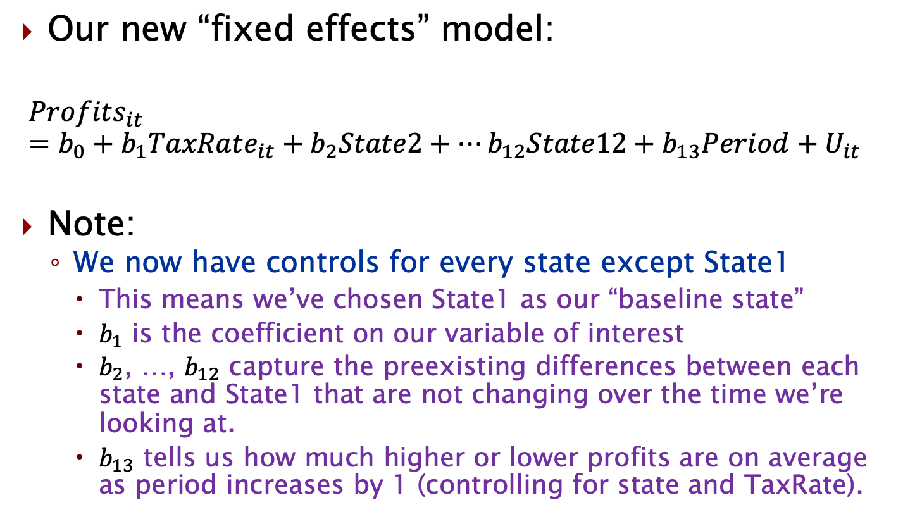
Fixed Effects Model
Our new “fixed effects” model:
$$Profits_{it}=b_{0}+b_{1}TaxRate_{it}+b_{2}State2+…b_{12}State12+b_{13}Period+U_{it}$$
Note:
We now have controls for every state except State1
This means we’ve chosen State1 as our “baseline state”
$b_{1}$ is the coefficient on our variable of interest
$b_{2}$, …, $b_{12}$ capture the preexisting differences between each state and State1 that are not changing over the time we’re looking at.
$b_{13}$ tells us how much higher or lower profits are on average as period increases by 1 (controlling for state and TaxRate).
Notes:
Including all the states causes a multicollinearity problem. It’s impossible to execute a regression when one X can be written as a linear combination of the other Xs. Try running this regression with all the state dummies in there.
Note that you could add dummies for each year (except a base year) – this is even more flexible, but also requires more from your data.

Slide 47
Fixed Effects Model
What do these results suggest?
Leaving out the controls caused a positive bias in the effect of the tax rate
Perhaps taxes were higher in states with bigger Profits
Or, Profits were increasing over time, and so were tax rates

Slide 48
Fixed Effects Model
Some notes on fixed effects models:
Fixed effects refers to cross-sectional units, not time
The controls for cross-sectional units and time do not eliminate all possible confounding factors
We can always add more controls (Xs)
They should vary across cross-sectional units and across time…otherwise they are unhelpful

Slide 49
Fixed Effects Model
Estimating the regression equation with fixed effects and time controls is one way of estimation
It is usually called a “dummy variable” approach
Note how to interpret the coefficient estimates using the dummy variable approach:
TaxRate
Period
State dummies

Slide 50
Power of panel data
Lots of things can be confounding factors.
Hard to observe ones like effort, determination, quality, etc. are particularly problematic.
For characteristics that do not change over time though, we can control for them if we have panel data.
Dummy variable on each entity controls for fixed effects of those entities.

Slide 51
This is really powerful!!
The dummy variables on each entity control for all characteristics that are not changing over the time periods for any entity.
We do not even have to observe them!!
The time variables controls for all characteristics that are changing over the time periods for but are changing in parallel for all entities.
We do not even have to observe them!!

Slide 52
Limitations of R-squared

Slide 53
Limitations of R-squared
When correlation is the only focus of the model (passive prediction), R-squared is extremely important.
Even in these cases though, it has limits.
When causation is the focus of the model, R-squared offers us very little information (if any).

Slide 54
Limitations of R-squared
In the following slides, we’ll look at a sample of data scraped from Airbnb listings in Austin, TX.
We’ll discuss what the R-squared can and can’t tell us about the relationship between Y and Xs in terms of:
Correlation
Causation

Slide 55
Regression and hypothesis tests
Let’s take a look at the following regression:
regress price entire_home
Interpret the following:
Coefficient on entire_home
What does R-squared tell us?
What can/can’t we say about causality here?

Slide 56
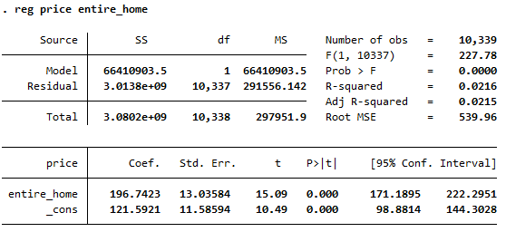
Simple regression example

Slide 57
R-squared
R squared tells us how much of the total variation in Y can be “explained” by the variation in X.
Think of this as a measurement of correlation and how closely the other variables move with Y.
This has a lot of value when we are focusing on co-movement of variables, but much less in causal inference.

Slide 58
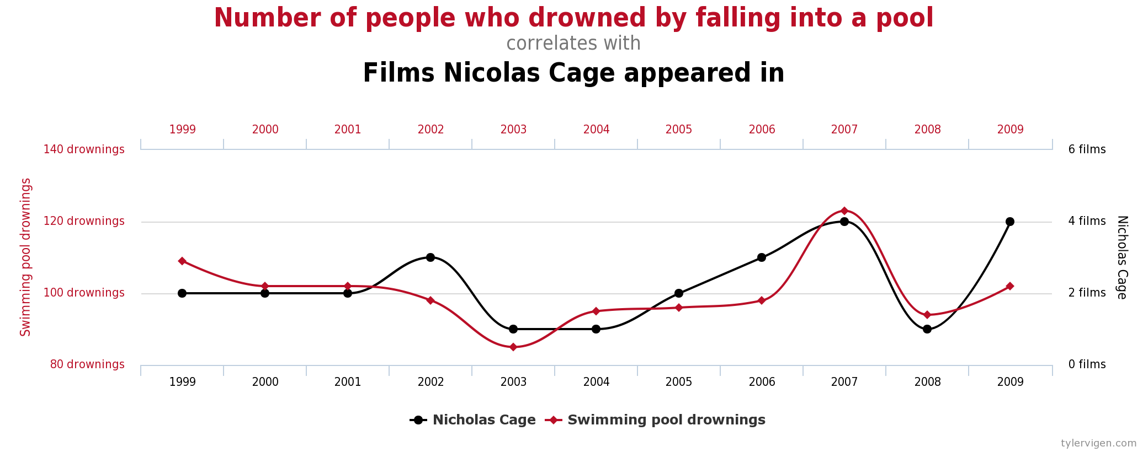
Example of very high R-squared
If we regressed # of people drowning by falling into a pool on # Nicholas cage films, we’d see a high R-squared over these years.
Does this imply other factors have little/no role?

Slide 59
What else is going on?
Going back to price and entire_home:
Since this is observational data (how can we tell that?), we can’t directly use it to infer a causal impact of entire_home on price.
Why not? What else is changing?

Slide 60
Let’s add some additional variables
Run the following regression and interpret the output:
reg price entire_home beds bedrooms

Slide 61
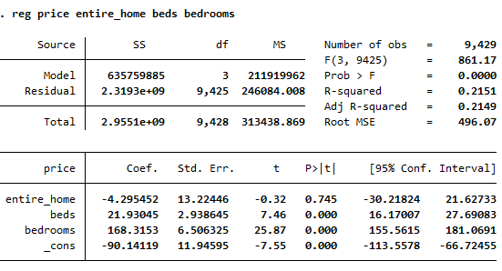
Let’s add an additional variable
What does R-squared tell us?
What does/doesn’t this say about causality?

Slide 62
Limitations of R-squared
With observational (non-experimental) data, it doesn’t matter how high the R-squared is, coefficients cannot be interpreted as causal.
Unless we can ensure that (all) other variables impacting Y are controlled for.
This can be done with experimental (RCT) data.

Slide 63
Overfitting/Training a Model
When can R-squared be “too” high?

Slide 64
Overfitting
Overfitting is the other limitation of R-squared.
Here we are not likely focused on causation, but just want to predict how 2 or more variables will move together.
Higher R-squared is generally better, with the exception of overfitting.

Slide 65

Why is overfitting a problem?
Fit can be 100% but out-of-sample prediction is terrible.
Suppose the true DGP is $Y=β_{0}+β_{1}X+β_{2}X^{2}+ε$.
Data points you see is the sum of effects of X and errors, which should not be attributed to X.

Slide 66
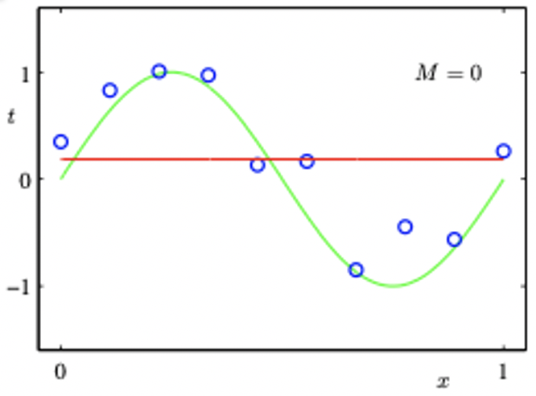

Doina Precup and Guillaume Rabusseau 2017
Green: true determining function in the DGP. $Y=β_{0}+β_{1}X+β_{2}X^{2}+ε$
Blue dots: data points in sample.
Suppose you fit these data points with intercept only. $Y=b_{0}+U$
Red: fitted/predicted line. $\hat{Y}={\hat{b}}_{0}$
In-sample prediction error: at each blue dot, distance between the dot and the red line.
Poor fit
Large error

Slide 67
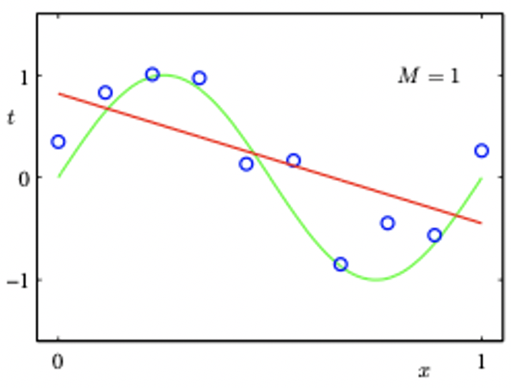

Doina Precup and Guillaume Rabusseau 2017
Suppose you fit these data points linearly. $Y=b_{0}+b_{1}X+U$
Red: fitted/predicted line. $\hat{Y}={\hat{b}}_{0}+{\hat{b}}_{1}X$.
In-sample prediction?
Out of sample prediction?

Slide 68
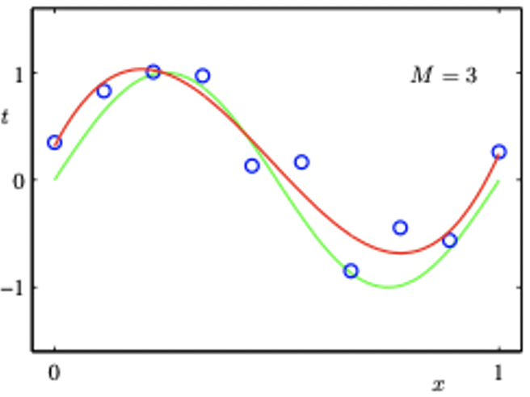

Doina Precup and Guillaume Rabusseau 2017
Suppose you fit these data points quadratically. $Y=b_{0}+b_{1}X+b_{2}X^{2}+U$
Red: fitted/predicted line. $\hat{Y}={\hat{b}}_{0}+{\hat{b}}_{1}X+{\hat{b}}_{2}X^{2}$
In-sample prediction?
Good but not perfect.
There are still errors.
Out of sample prediction?

Slide 69
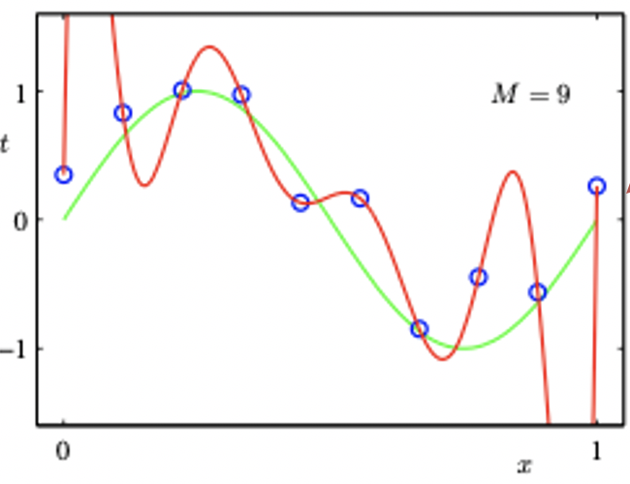
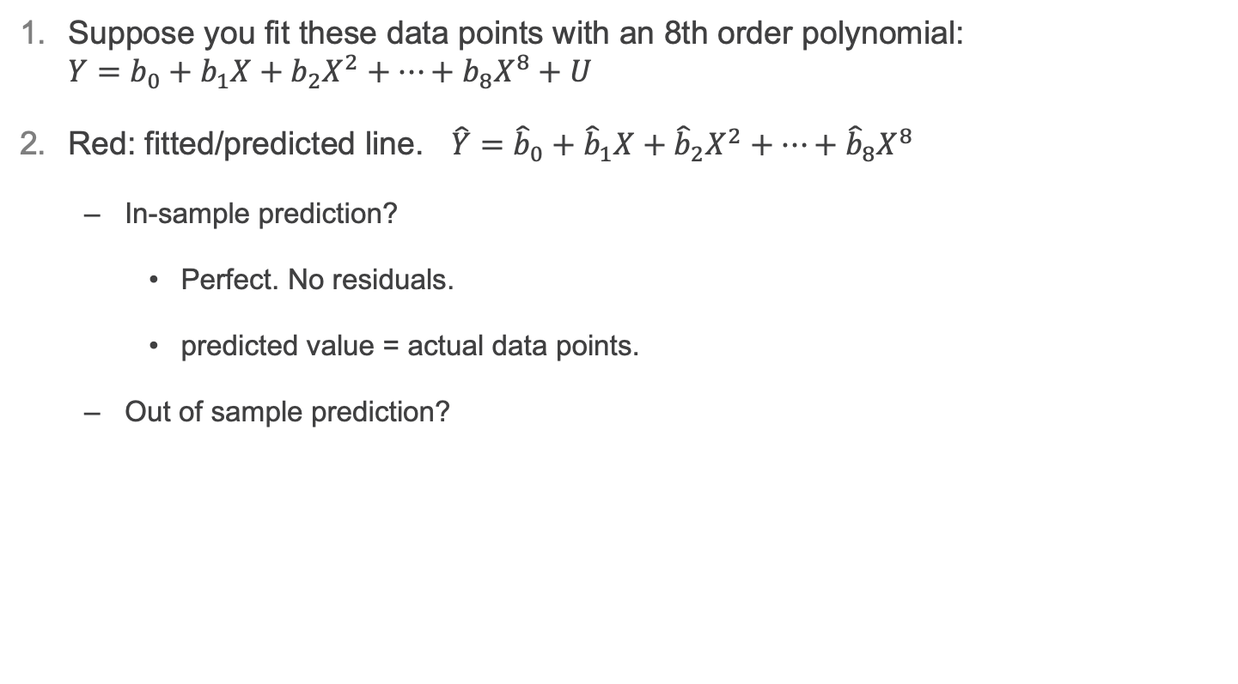
Doina Precup and Guillaume Rabusseau 2017
Suppose you fit these data points with an 8th order polynomial: $Y=b_{0}+b_{1}X+b_{2}X^{2}+…+b_{8}X^{8}+U$
Red: fitted/predicted line. $\hat{Y}={\hat{b}}_{0}+{\hat{b}}_{1}X+{\hat{b}}_{2}X^{2}+…+{\hat{b}}_{8}X^{8}$
In-sample prediction?
Perfect. No residuals.
predicted value = actual data points.
Out of sample prediction?
Perfect fit
But not accurate.

Slide 70
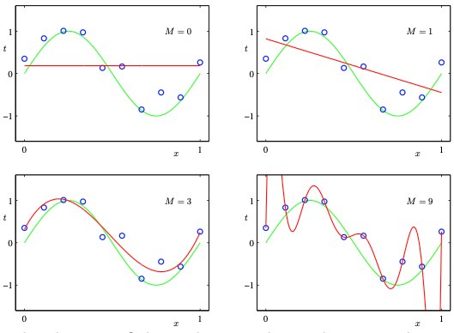
Precup and Rabusseau (2017)
When too many Xs are added…
Perfect fit but not accurate: it does not mimic the true determining function.
Consequence: prediction at out-of-sample X is way off.
It overfits Y with a functional form that is ”overly complex,” stealing contribution from the errors.

Slide 71
Overfitting
Because overfitting is a problem, rather than say:
”Higher R-squared is better”
We should say:
“Higher R-squared is better, if consistently high in-sample and out-of-sample.”
*This is not typically relevant for causation.

Slide 72
Announcements/reminders
PS3 solutions up
Sample final exam solutions up
https://coursequestionnaire.iu.edu/
Final exam on Wednesday on your own during class time
You have 80 minutes (out of 90 minute window) to take exam
20 questions on Canvas
18 multiple choice questions
2 short answer (similar to “why?/explain” questions from HW)
None require you to access Stata

